Slide 1
IV3 Local Average Treatment Effects

Slide 2
Overview
Reading: Ch 7.8.1
Today:
Heterogeneous treatment effects
Local average treatment effects (LATE)
Discuss: Angrist (1990) Lifetime Earnings and the Vietnam Draft Lottery
Lab: Card (1993) College Proximity and Returns to Schooling

Slide 3
Motivation
The housing bubble on college attendance

Slide 4
The 2000s housing bubble affected a subset of people
Charles, Hurst, and Notowidigdo (2018) Housing Booms and Busts, Labor Market Opportunities, and College Attendance
The 2000s housing bubble induced
(mostly) male high school graduates considering community college
into the construction industry (they did not pursue higher education)
Recent HS graduates intending to do a bachelor’s degree were unaffected
Bachelor degree bound individuals did not respond to size of the local bubble as those who were associate degree bound

Slide 5
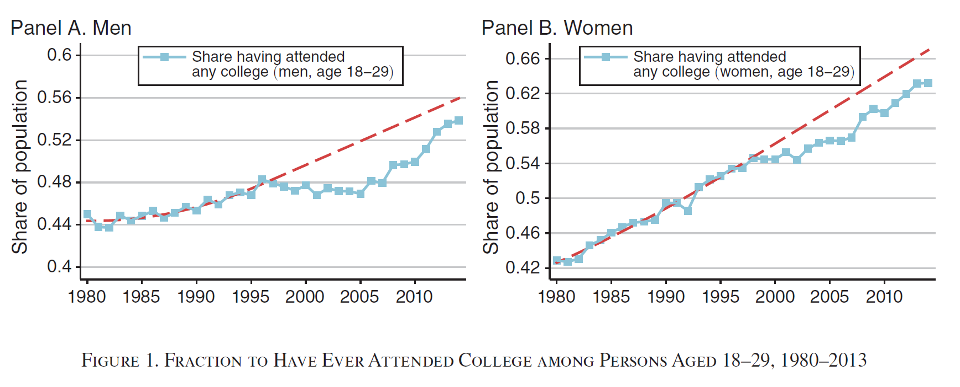
College attendance rates slowed during housing boom

Slide 6
The 2000s housing bubble affected a subset of people
Age Group | Bachelor’s Degree | Males | Females
Young students | Not desired | Unaffected | Unaffected
Young students | Desired | Unaffected | Unaffected
HS Graduates | Not desired | Strongly affected | Weakly affected
HS Graduates | Desired | Unaffected | Unaffected
Mid-Career | No | Unaffected | Unaffected
Mid-Career | Yes | Unaffected | Unaffected
Late-Career | No | Unaffected | Unaffected
Late-Career | Yes | Unaffected | Unaffected

Slide 7
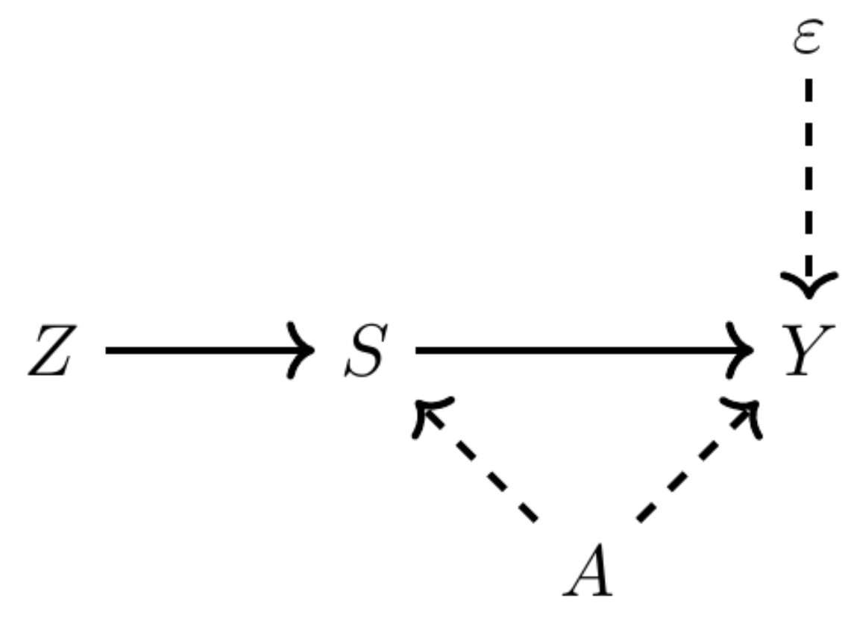
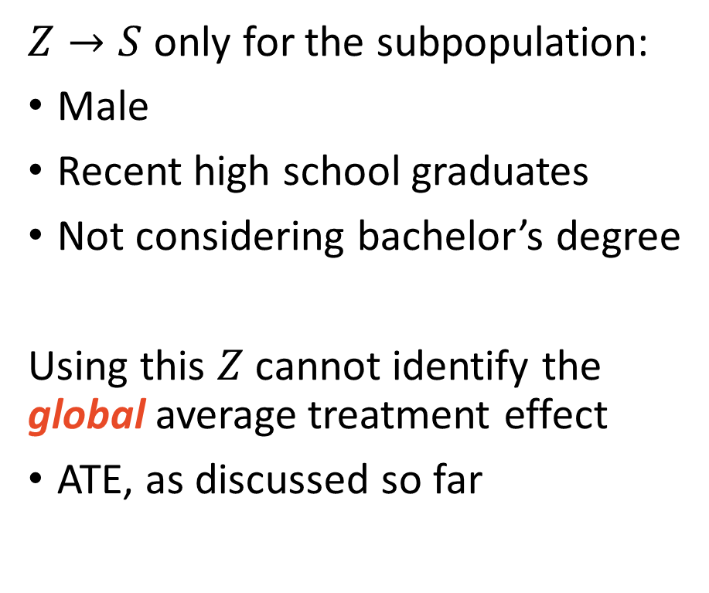
The 2000s housing bubble affected a subset of people
$Z→S$ only for the subpopulation:
Male
Recent high school graduates
Not considering bachelor’s degree
Using this $Z$ cannot identify the global average treatment effect
ATE, as discussed so far

Slide 8
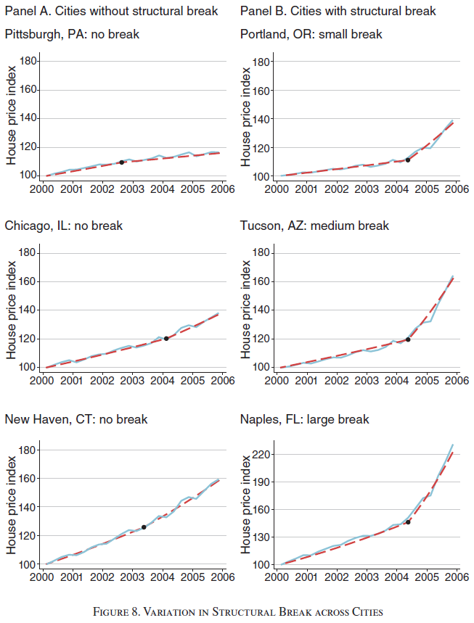

$Z$: inflection size

Slide 9
Heterogenous Treatment Effects
The same treatment affects individuals differently

Slide 10
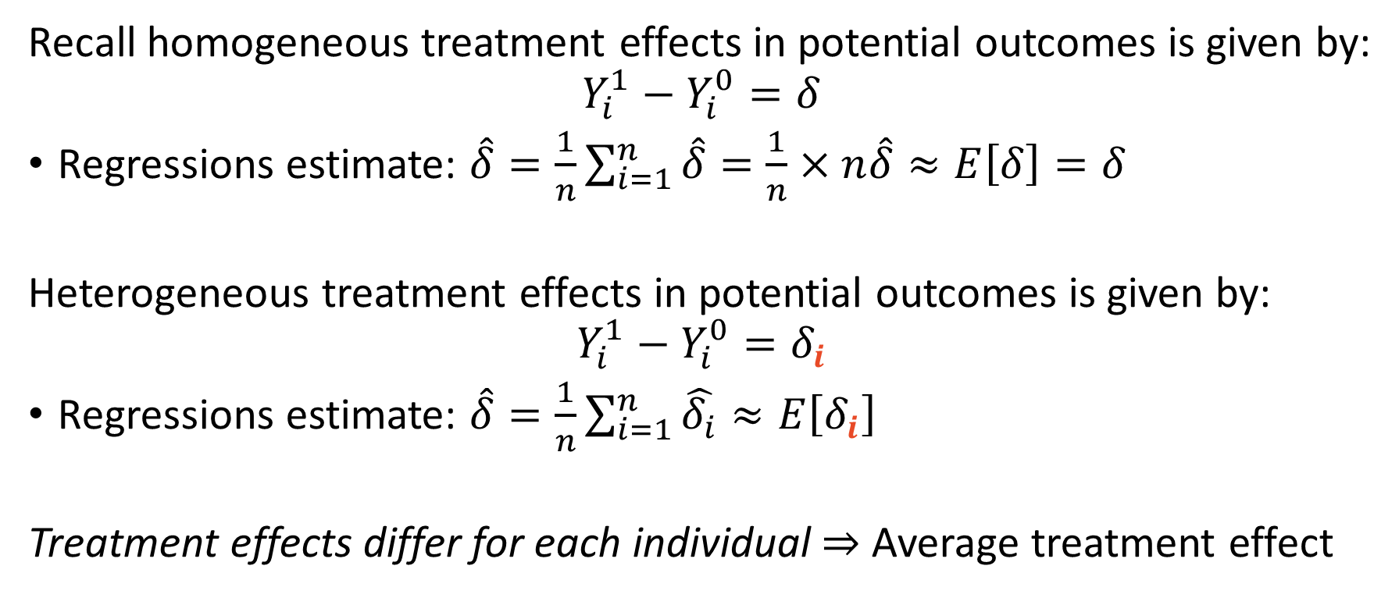
Refresher in Potential Outcomes Framework
Recall homogeneous treatment effects in potential outcomes is given by:
$$Y_{i}^{1}−Y_{i}^{0}=δ$$
Regressions estimate: $\hat{δ}=\frac{1}{n}\sum_{i=1}^{n}{\hat{δ}}=\frac{1}{n}×n\hat{δ}≈E\left[δ\right]=δ$
Heterogeneous treatment effects in potential outcomes is given by:
$$Y_{i}^{1}−Y_{i}^{0}=δ_{i}$$
Regressions estimate: $\hat{δ}=\frac{1}{n}\sum_{i=1}^{n}{\hat{δ_{i}}}≈E\left[δ_{i}\right]$
Treatment effects differ for each individual $⇒$ Average treatment effect

Slide 11
IV questions under heterogeneous treatment
If each individual responds to treatment differently:
Q1) What is IV actually estimating?
Housing bubble only affected schooling choices for those considering community college, not those considering a bachelor’s degree.
Q2) What are the assumptions for IV to estimate a causal affect?
Was the housing bubble randomly assigned?
Did the affected subpopulation all respond in the same direction?

Slide 12
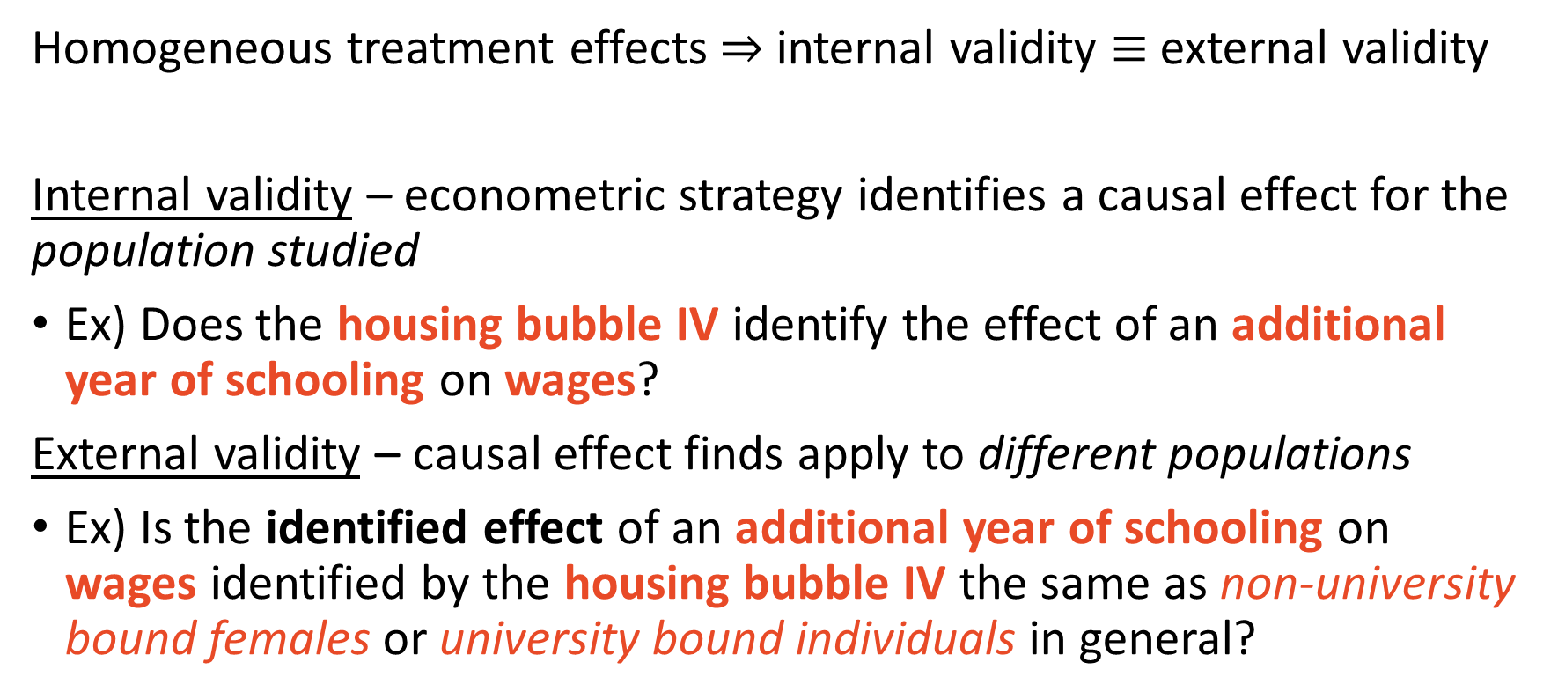
Internal vs. external validity matters with hetero. effects
Homogeneous treatment effects $⇒$ internal validity $≡$ external validity
Internal validity – econometric strategy identifies a causal effect for the population studied
Ex) Does the housing bubble IV identify the effect of an additional year of schooling on wages?
External validity – causal effect finds apply to different populations
Ex) Is the identified effect of an additional year of schooling on wages identified by the housing bubble IV the same as non-university bound females or university bound individuals in general?

Slide 13
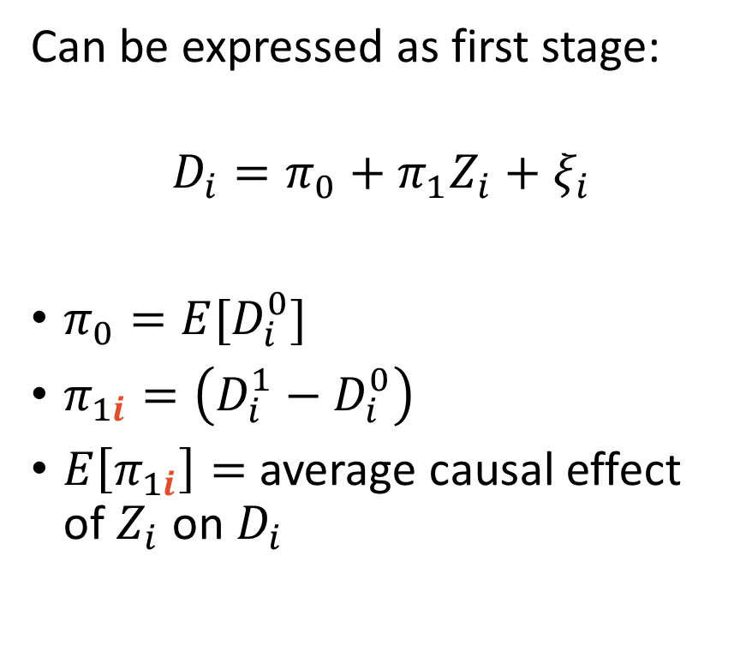
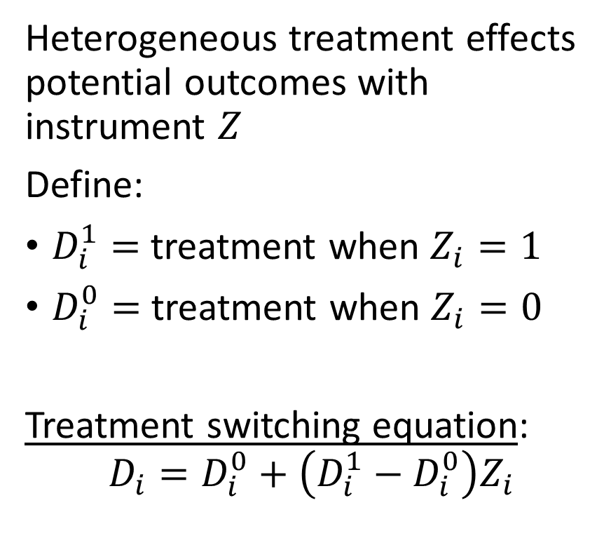
Hetero effects with IV in potential outcomes
Heterogeneous treatment effects potential outcomes with instrument $Z$
Define:
$D_{i}^{1}=$ treatment when $Z_{i}=1$
$D_{i}^{0}=$ treatment when $Z_{i}=0$
Treatment switching equation:
$$D_{i}=D_{i}^{0}+\left(D_{i}^{1}−D_{i}^{0}\right)Z_{i}$$
Can be expressed as first stage:
$$D_{i}=π_{0}+π_{1}Z_{i}+ξ_{i}$$
$π_{0}=E{[D}_{i}^{0}]$
$π_{1i}=\left(D_{i}^{1}−D_{i}^{0}\right)$
$E\left[π_{1i}\right]=$ average causal effect of $Z_{i}$ on $D_{i}$

Slide 14
Local Average Treatment Effects
The average treatment affect for the subpopulation affected by the instrument

Slide 15
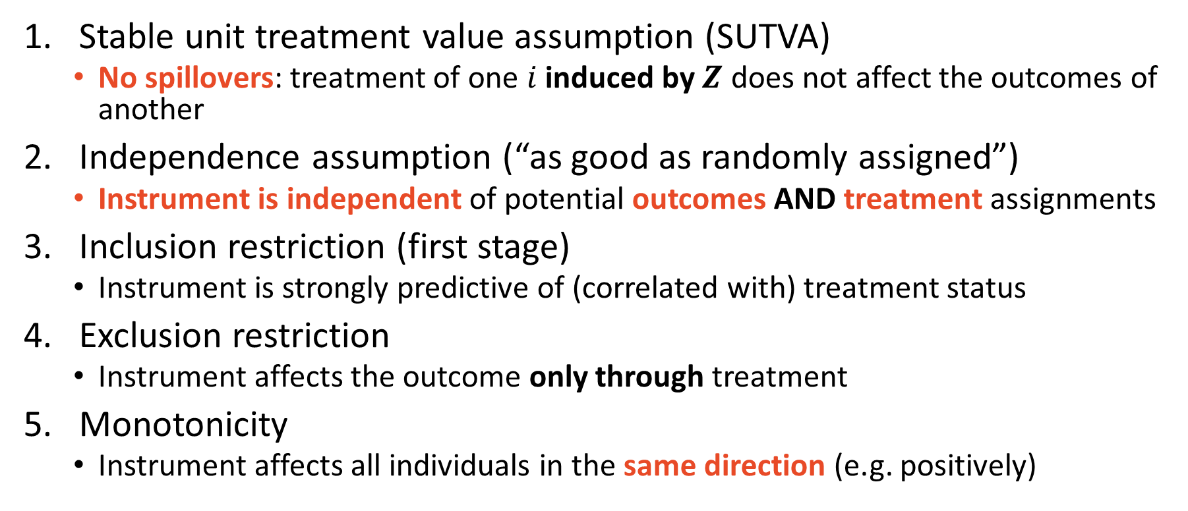
Assumptions required to identify LATE
Stable unit treatment value assumption (SUTVA)
No spillovers: treatment of one $i$ induced by $Z$ does not affect the outcomes of another
Independence assumption (“as good as randomly assigned”)
Instrument is independent of potential outcomes AND treatment assignments
Inclusion restriction (first stage)
Instrument is strongly predictive of (correlated with) treatment status
Exclusion restriction
Instrument affects the outcome only through treatment
Monotonicity
Instrument affects all individuals in the same direction (e.g. positively)

Slide 16
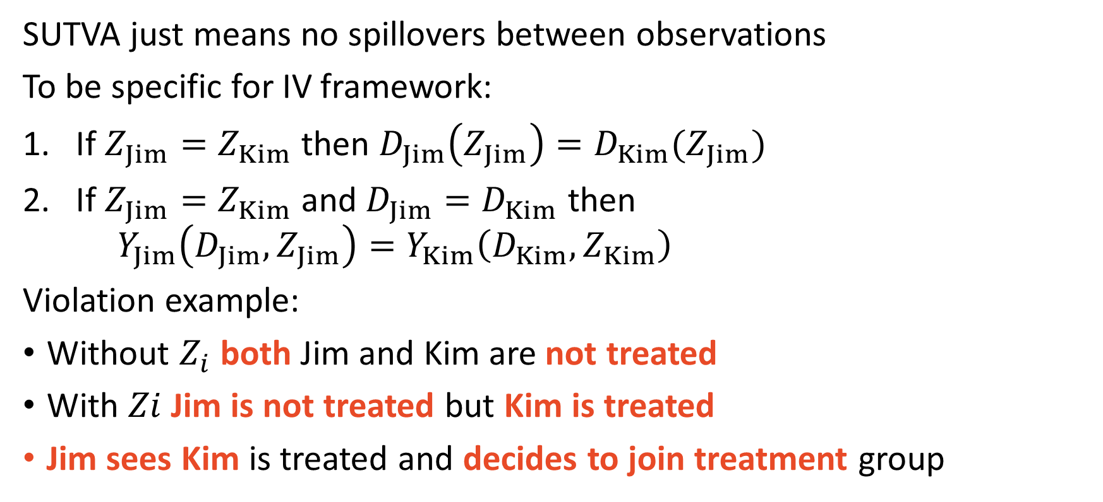
1) Stable Unit Treatment Value Assumption
SUTVA just means no spillovers between observations
To be specific for IV framework:
If $Z_{Jim}=Z_{Kim}$ then $D_{Jim}\left(Z_{Jim}\right)=D_{Kim}(Z_{Jim})$
If $Z_{Jim}=Z_{Kim}$ and $D_{Jim}=D_{Kim}$ then $Y_{Jim}\left(D_{Jim},Z_{Jim}\right)=Y_{Kim}\left(D_{Kim},Z_{Kim}\right)$
Violation example:
Without $Z_{i}$ both Jim and Kim are not treated
With $Zi$ Jim is not treated but Kim is treated
Jim sees Kim is treated and decides to join treatment group

Slide 17
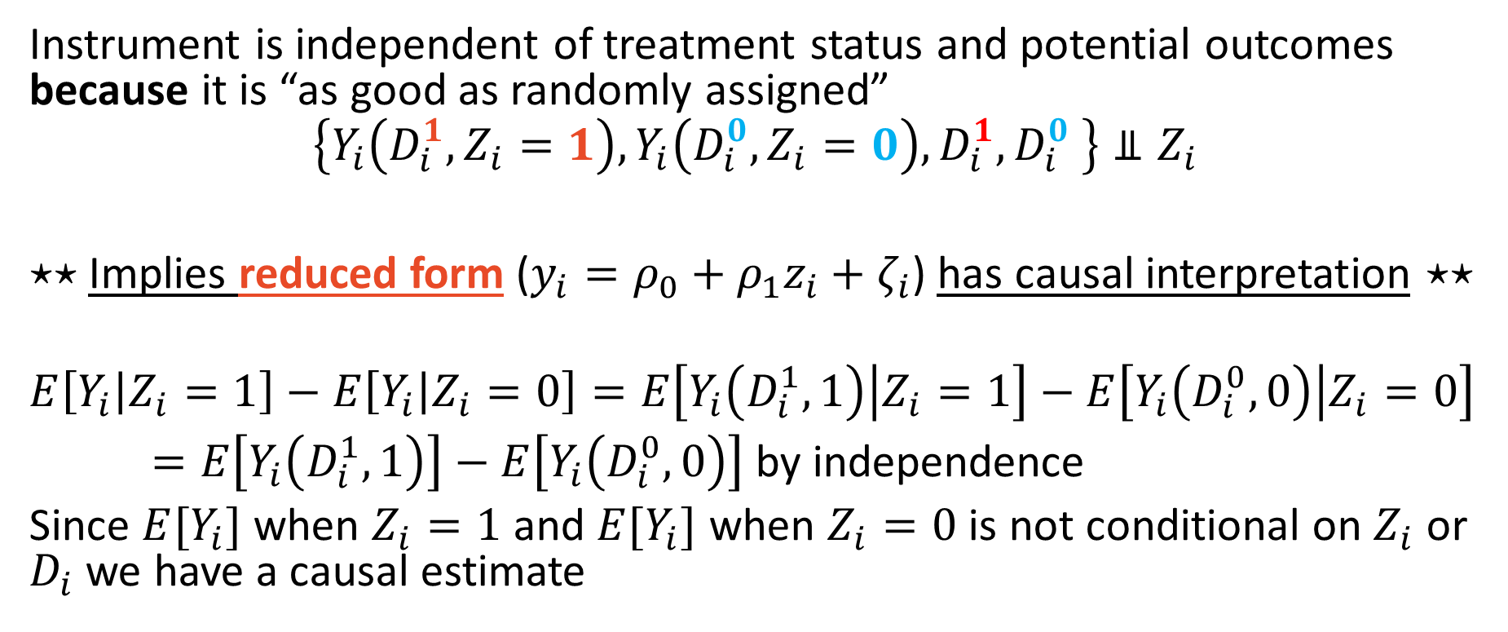
2) Independence
Instrument is independent of treatment status and potential outcomes because it is “as good as randomly assigned”
$$\left\{Y_{i}\left(D_{i}^{1},Z_{i}=1\right),Y_{i}\left(D_{i}^{0},Z_{i}=0\right),D_{i}^{1},D_{i}^{0} \right\}⫫Z_{i}$$
$⋆⋆$Implies reduced form ($y_{i}=ρ_{0}+ρ_{1}z_{i}+ζ_{i}$) has causal interpretation $⋆⋆$
$$E\left[Y_{i} | Z_{i}=1\right]−E\left[Y_{i} | Z_{i}=0\right]=E\left[Y_{i}\left(D_{i}^{1}, 1\right) | Z_{i}=1\right]−E\left[Y_{i}\left(D_{i}^{0},0\right) | Z_{i}=0\right]$$
$=E\left[Y_{i}\left(D_{i}^{1}, 1\right)\right]−E\left[Y_{i}\left(D_{i}^{0},0\right)\right]$ by independence
Since $E[Y_{i}]$ when $Z_{i}=1$ and $E[Y_{i}]$ when $Z_{i}=0$ is not conditional on $Z_{i}$ or $D_{i}$ we have a causal estimate

Slide 18
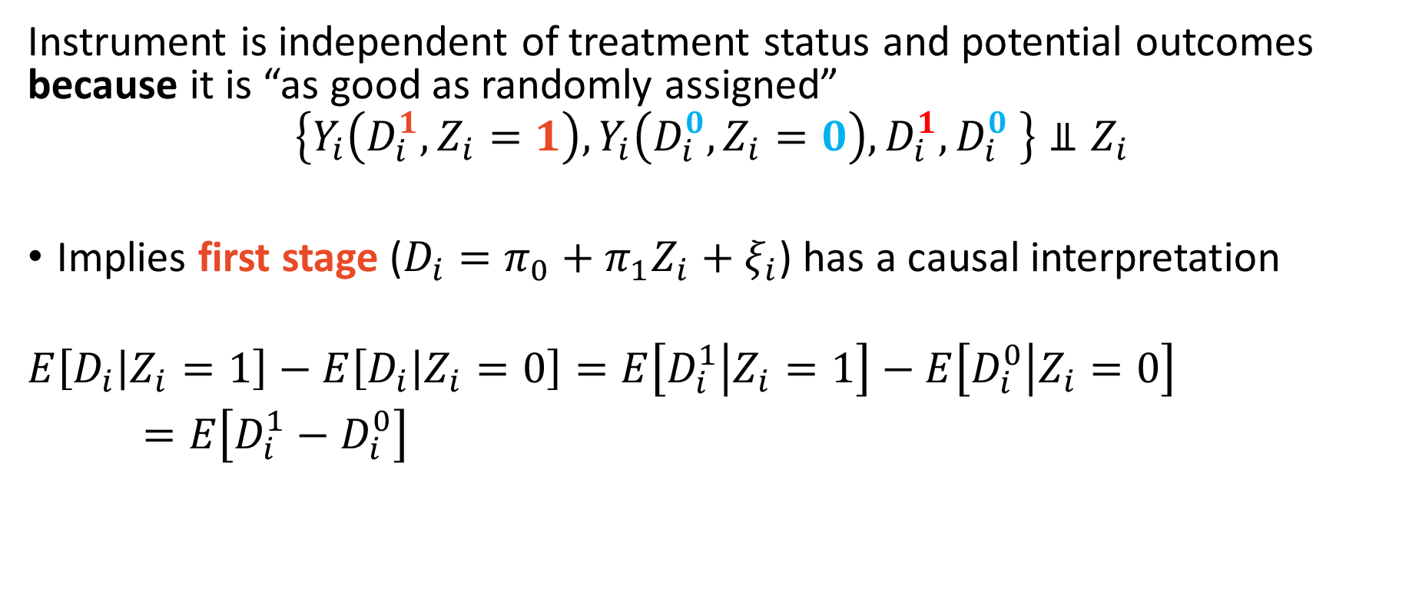
2) Independence
Instrument is independent of treatment status and potential outcomes because it is “as good as randomly assigned”
$$\left\{Y_{i}\left(D_{i}^{1},Z_{i}=1\right),Y_{i}\left(D_{i}^{0},Z_{i}=0\right),D_{i}^{1},D_{i}^{0} \right\}⫫Z_{i}$$
Implies first stage ($D_{i}=π_{0}+π_{1}Z_{i}+ξ_{i}$) has a causal interpretation
$$E\left[D_{i} | Z_{i}=1\right]−E\left[D_{i} | Z_{i}=0\right]=E\left[D_{i}^{1} | Z_{i}=1\right]−E\left[D_{i}^{0} | Z_{i}=0\right]$$
$=E\left[D_{i}^{1}−D_{i}^{0}\right]$

Slide 19
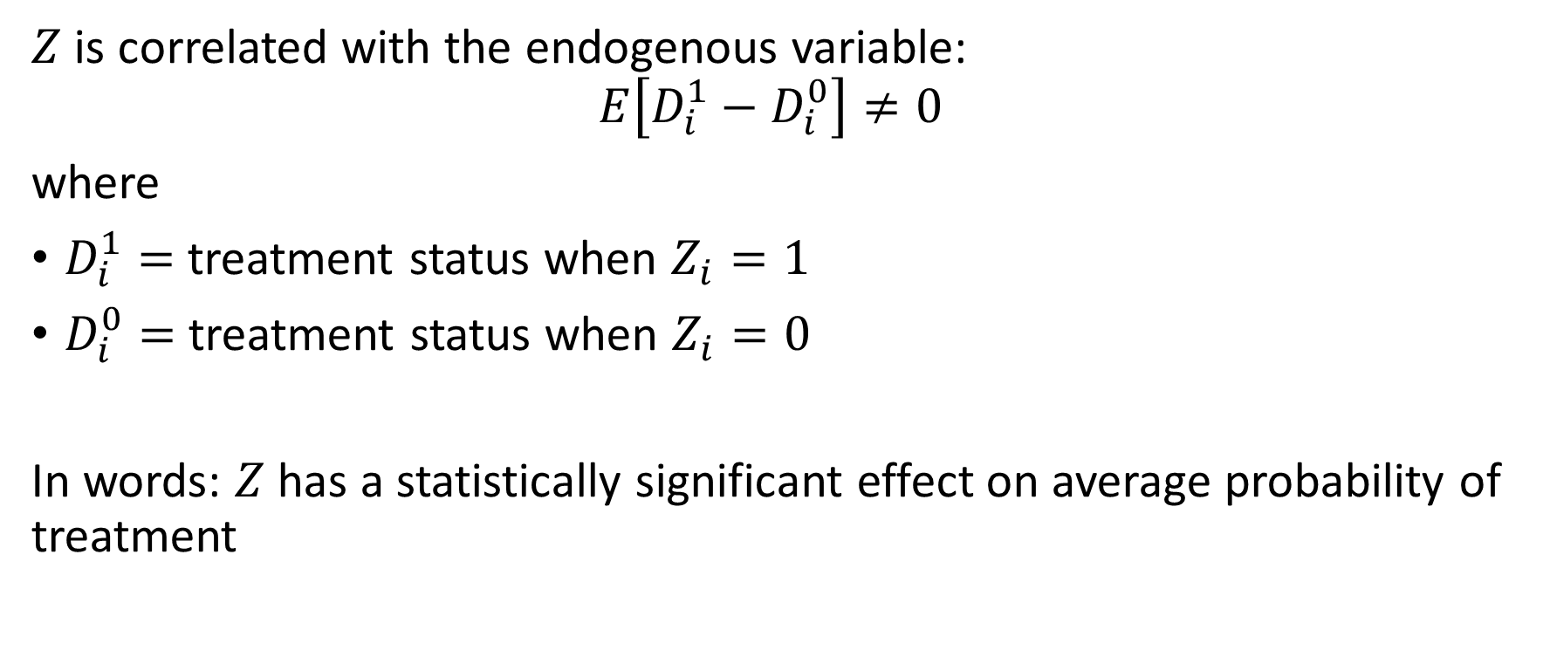
3) Inclusion Restriction
$Z$ is correlated with the endogenous variable:
$$E\left[D_{i}^{1}−D_{i}^{0}\right]≠0$$
where
$D_{i}^{1}=$ treatment status when $Z_{i}=1$
$D_{i}^{0}=$ treatment status when $Z_{i}=0$
In words: $Z$ has a statistically significant effect on average probability of treatment

Slide 20
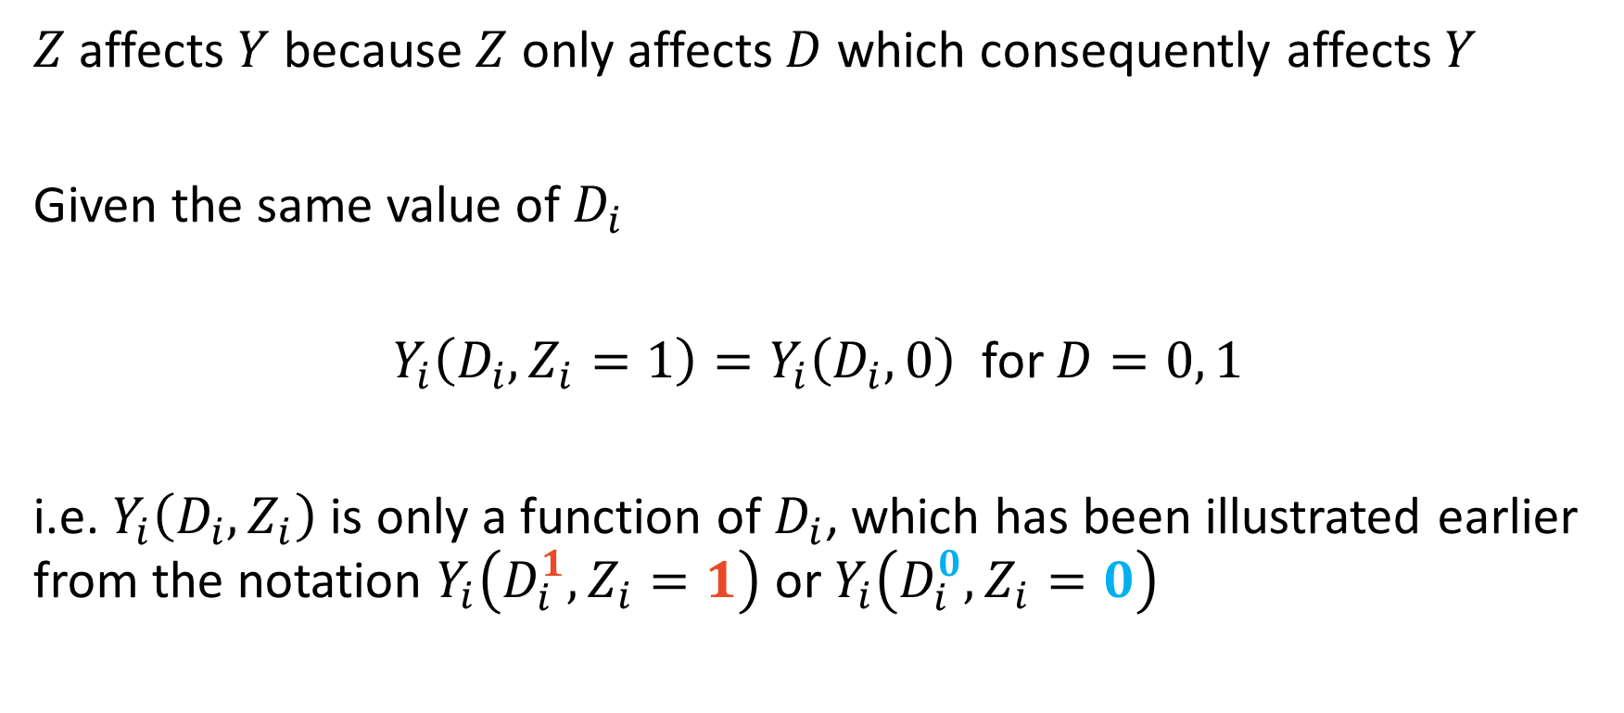
4) Exclusion Restriction
$Z$ affects $Y$ because $Z$ only affects $D$ which consequently affects $Y$
Given the same value of $D_{i}$
$Y_{i}\left(D_{i},Z_{i}=1\right)=Y_{i}\left(D_{i},0\right)$ for $D=0, 1$
i.e. $Y_{i}\left(D_{i},Z_{i}\right)$ is only a function of $D_{i}$, which has been illustrated earlier from the notation $Y_{i}\left(D_{i}^{1},Z_{i}=1\right)$ or $Y_{i}\left(D_{i}^{0},Z_{i}=0\right)$

Slide 21
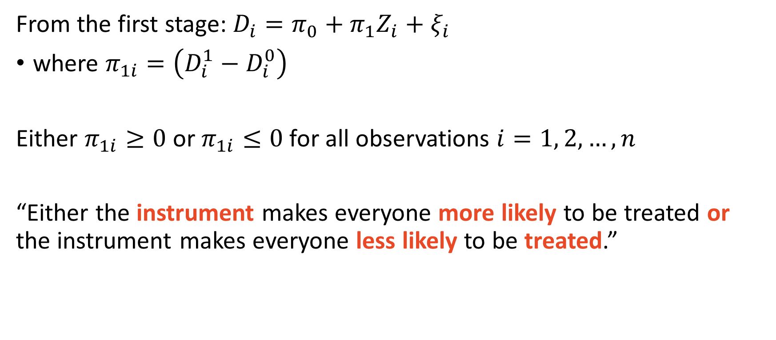
5) Monotonicity
From the first stage: $D_{i}=π_{0}+π_{1}Z_{i}+ξ_{i}$
where $π_{1i}=\left(D_{i}^{1}−D_{i}^{0}\right)$
Either $π_{1i}≥0$ or $π_{1i}≤0$ for all observations $i=1, 2, …, n$
“Either the instrument makes everyone more likely to be treated or the instrument makes everyone less likely to be treated.”

Slide 22
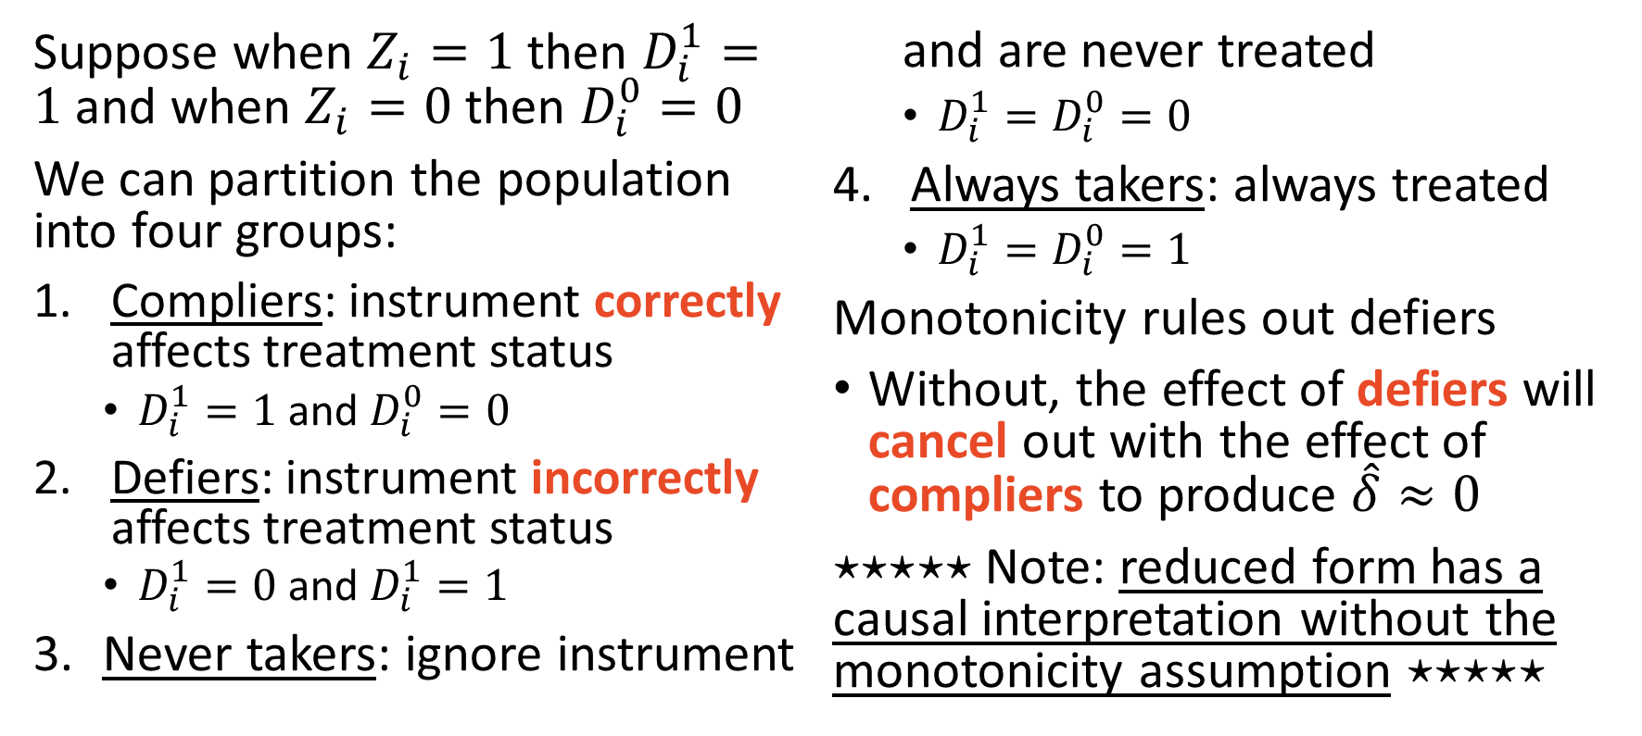
5) Monotonicity: instrument compliance
Suppose when $Z_{i}=1$ then $D_{i}^{1}=1$ and when $Z_{i}=0$ then $D_{i}^{0}=0$
We can partition the population into four groups:
Compliers: instrument correctly affects treatment status
$D_{i}^{1}=1$ and $D_{i}^{0}=0$
Defiers: instrument incorrectly affects treatment status
$D_{i}^{1}=0$ and $D_{i}^{1}=1$
Never takers: ignore instrument and are never treated
$D_{i}^{1}=D_{i}^{0}=0$
Always takers: always treated
$D_{i}^{1}=D_{i}^{0}=1$
Monotonicity rules out defiers
Without, the effect of defiers will cancel out with the effect of compliers to produce $\hat{δ}≈0$
$⋆⋆⋆⋆⋆$ Note: reduced form has a causal interpretation without the monotonicity assumption $⋆⋆⋆⋆⋆$

Slide 23
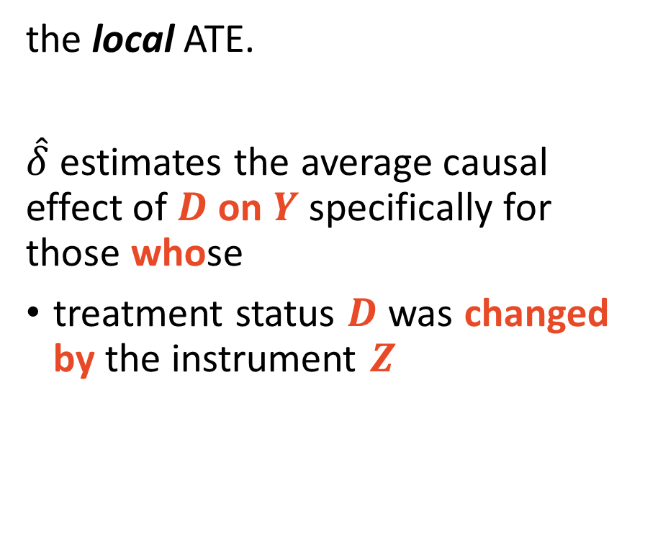
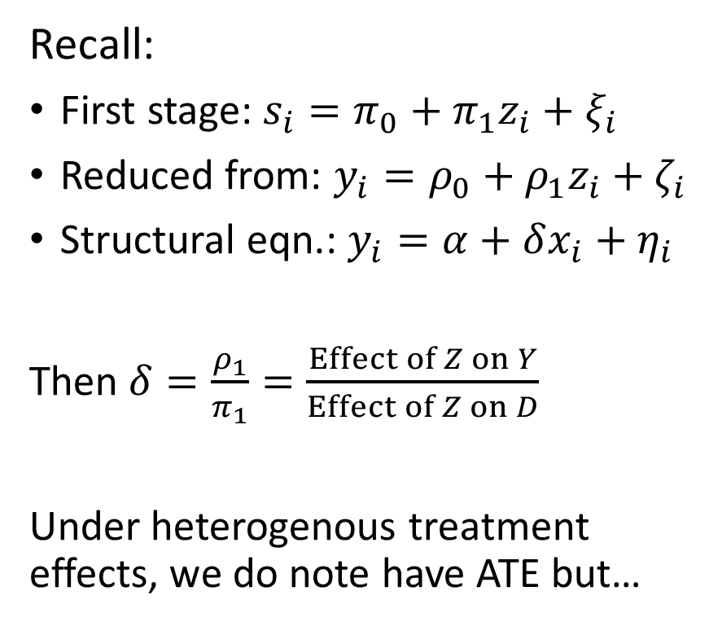
The Local Average Treatment Effect
Recall:
First stage: $s_{i}=π_{0}+π_{1}z_{i}+ξ_{i}$
Reduced from: $y_{i}=ρ_{0}+ρ_{1}z_{i}+ζ_{i}$
Structural eqn.: $y_{i}=α+δx_{i}+η_{i}$
Then $δ=\frac{ρ_{1}}{π_{1}}=\frac{Effect of Z on Y}{Effect of Z on D}$
Under heterogenous treatment effects, we do note have ATE but…
the local ATE.
$\hat{δ}$ estimates the average causal effect of $D$ on $Y$ specifically for those whose
treatment status $D$ was changed by the instrument $Z$

Slide 24
Angrist (1990) Vietnam Draft on Lifetime Earnings
Using the randomized draft lottery as an instrument for endogenous military service

Slide 25
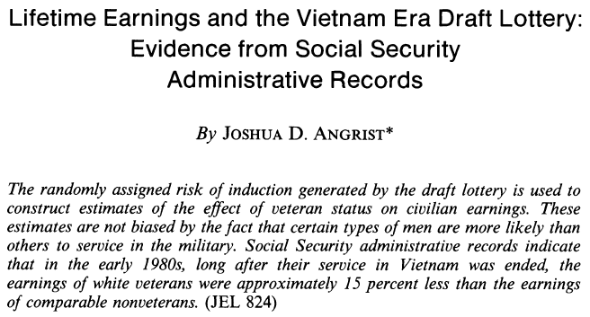
Angrist 1990 Lifetime Earnings and Military Service

Slide 26
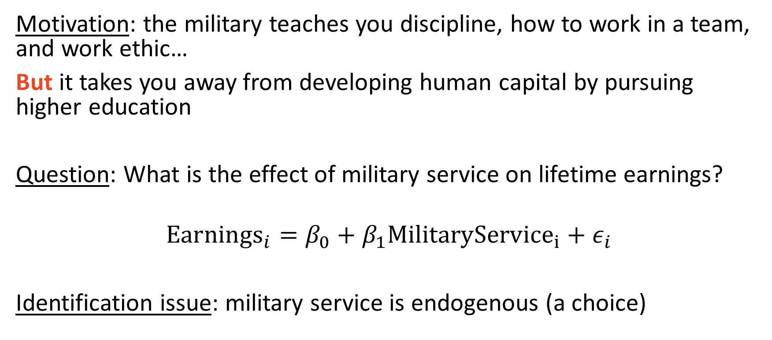
Angrist 1990 Lifetime Earnings and Military Service
Motivation: the military teaches you discipline, how to work in a team, and work ethic…
But it takes you away from developing human capital by pursuing higher education
Question: What is the effect of military service on lifetime earnings?
$${Earnings}_{i}=β_{0}+β_{1}{MilitaryService}_{i}+ε_{i}$$
Identification issue: military service is endogenous (a choice)

Slide 27
Angrist 1990 Lifetime Earnings and Military Service
Institutional background: during the Vietnam war, the draft was randomized like a lottery.
Random Sequence Numbers (RSN) that ranged from 1-365 were assigned to male cohorts eligible for the draft based on their birthdates
Men were conscripted by RSN up to a ceiling (1-195 in 1970, 1-125 in 1971, 1-95 in 1972)
Empirical Strategy:
Use randomly assigned RSNs to as an instrument for military service

Slide 28
Angrist 1990 Lifetime Earnings and Military Service
Findings:
White Vietnam war veterans had about 15% less lifetime earnings than comparable nonveterans
Non-white Vietnam war veterans did not have a statistically significant difference in lifetime earnings relative to comparable group

Slide 29
Angrist (1990) Asm. 1) SUTVA
No draft spillovers:
An individual being drafted did not cause another to enlist
A violation story:
Imagine young adult brothers, and the younger gets conscripted
The older enlisting because his younger brother was drafted would violate SUTVA
Did this happen?
Almost certainly.
Is it an identification threat?
Only if there was nontrivial amount of occurrences (ask the data)

Slide 30
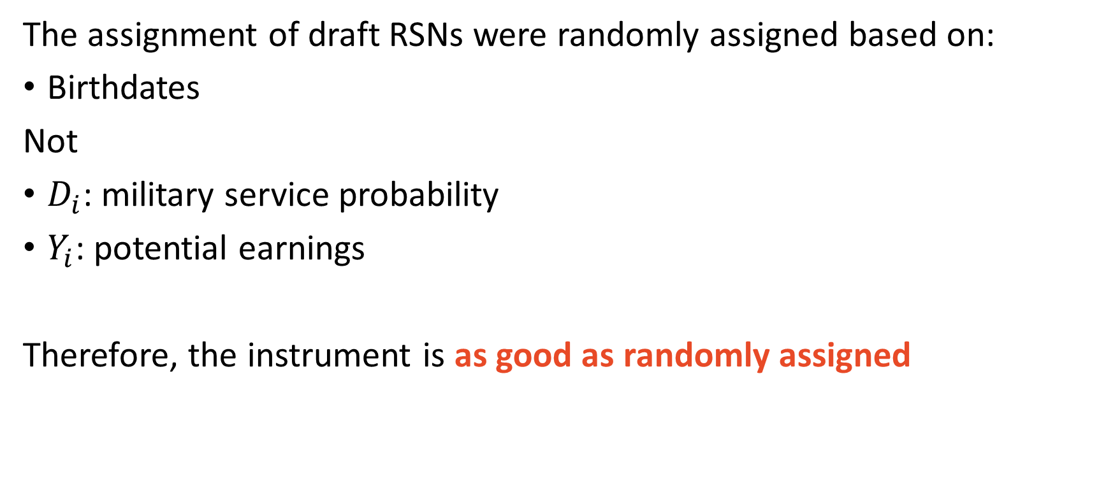
Angrist (1990) Asm. 2) Independence
The assignment of draft RSNs were randomly assigned based on:
Birthdates
Not
$D_{i}$: military service probability
$Y_{i}$: potential earnings
Therefore, the instrument is as good as randomly assigned

Slide 31
Angrist (1990) Asm. 3) Inclusion Restriction
Are the RSNs strong predictors of the average probability of military service?
Lower RSNs were more likely to be conscripted
Intuitively, yes
Violation Story
If everyone in the draft-eligible cohort enlisted anyway, then no
This is testable in the data

Slide 32
Angrist (1990) Asm. 4) Exclusion Restriction
A low lottery number does not directly affect lifetime earnings
Violation Story
Having a low RSN induced individuals to avoid the draft via college
Therefore, affecting lifetime earnings potential
Test:
Microdata RSNs are predictive of only military service

Slide 33
Angrist (1990) Asm. 5) Monotonicity
Rule out defiers.
“I’m going to enlist to protect my homeland!”
Gets called for draft
“Now I am not going to because you are forcing me to…”
This maybe happened, but if it did only an inconsequential amount

Slide 34
Angrist (1990) Internal and External Validity
Internal validity
Assumptions 1-5 seem to be satisfied
Therefore, empirical strategy identifies a causal effect
External Validity
The majority in the military during the Vietnam war chose to be there
IV only estimates the subpopulation that were drafted
Might not represent non-drafted veterans (e.g. Gulf war)

Slide 35
Card (1993/5) College Proximity and Returns to Schooling
The local part of LATE is all about the compliers

Slide 36

Card (1993) College Proximity on Schooling Returns

Slide 37
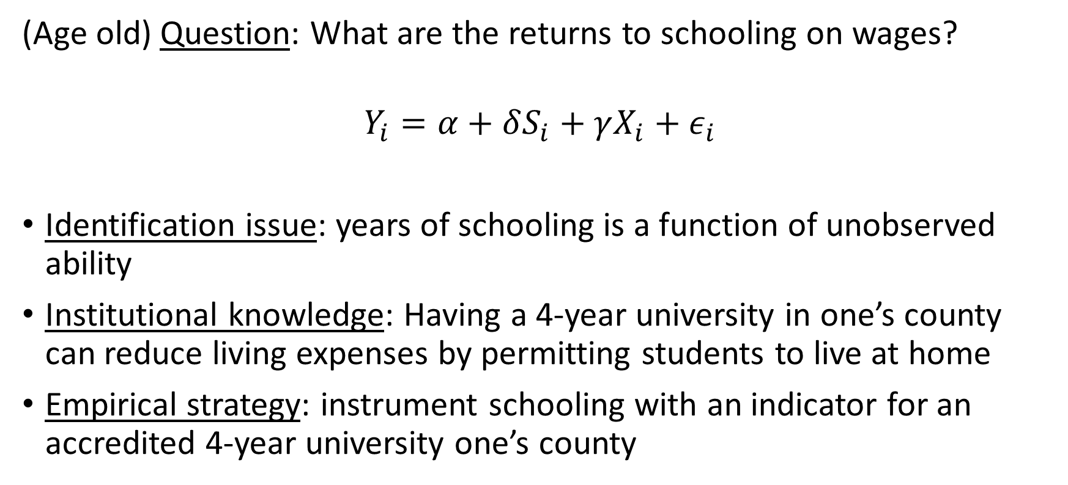
Card (1993) College Proximity on Schooling Returns
(Age old) Question: What are the returns to schooling on wages?
$$Y_{i}=α+δS_{i}+γX_{i}+ε_{i}$$
Identification issue: years of schooling is a function of unobserved ability
Institutional knowledge: Having a 4-year university in one’s county can reduce living expenses by permitting students to live at home
Empirical strategy: instrument schooling with an indicator for an accredited 4-year university one’s county

Slide 38
Card (1993) Asm. 1) SUTVA
Require treatment of one student to not affect the treatment of another
Does a student going to college in one county affect another student’s decision to go college in another county?
Probably not

Slide 39
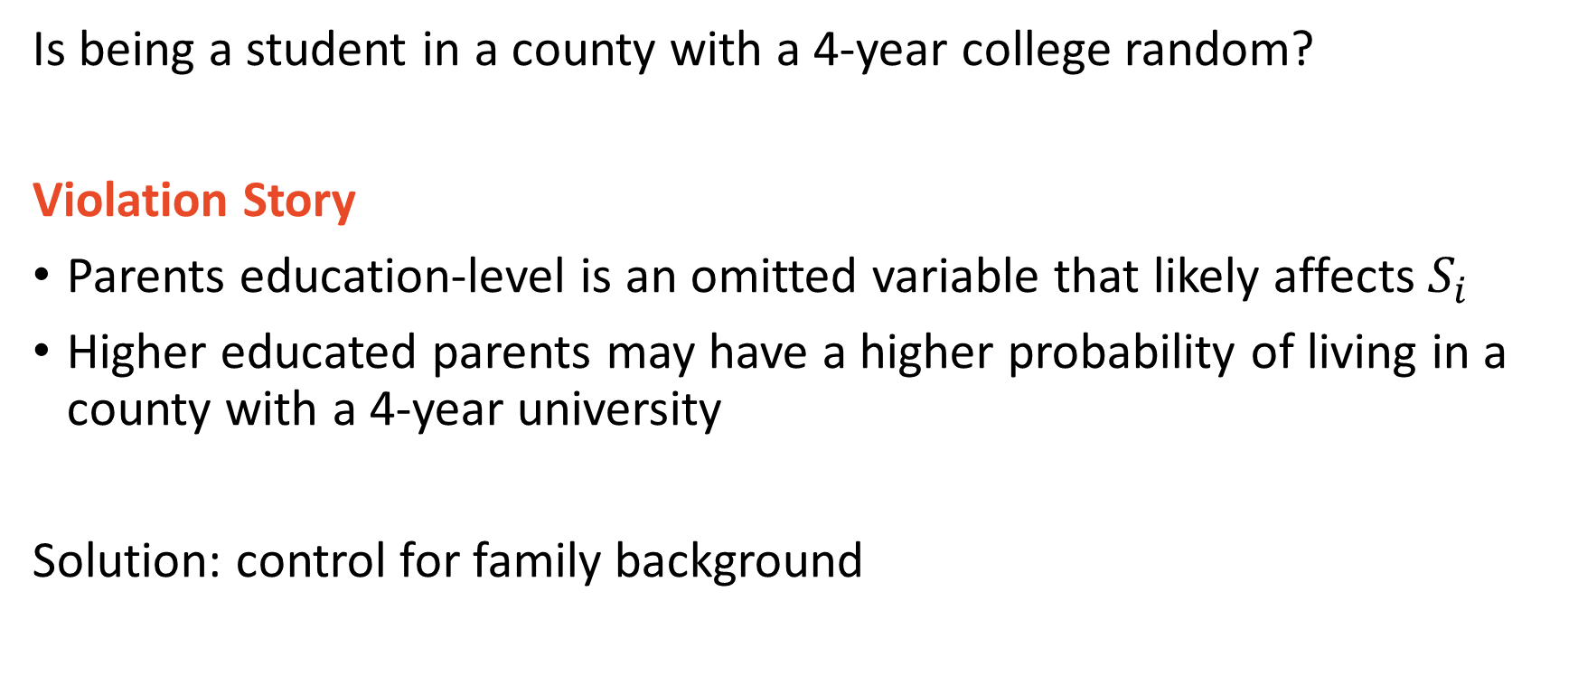
Card (1993) Asm. 2) Independence
Is being a student in a county with a 4-year college random?
Violation Story
Parents education-level is an omitted variable that likely affects $S_{i}$
Higher educated parents may have a higher probability of living in a county with a 4-year university
Solution: control for family background

Slide 40
Card (1993) Asm. 3) Inclusion Restriction
Does the presence of a college in one’s county predict level of education?
Yes, highly educated counties tend to have higher levels of student educational attainment.
Can be tested in the data, nonetheless

Slide 41
Card (1993) Asm. 4) Exclusion Restriction
Can having a college in the county affect wages through alternative channels other than an individual’s educational attainment?
Consider the following general equilibrium effect:
If counties with a college have a higher educated workforce
Company demand for workers increases
Average wages in higher educated areas will the be higher
Then the same worker would earn more with a college-in-the-county
This violation story is supported in the data

Slide 42
Card (1993) Asm. 5) Monotonicity
Are there defiers?
Are there students who would go to college if there was not a college in their county but would not go if there was a college in their county?
Violation Story: Maybe.
If counties with a college have better economic opportunities for those without college degrees
This is a very difficult narrative to test; it is a question being asked in research at the forefront of economic knowledge

Slide 43
Card (1993) Internal and External Validity
Internal validity: is causality identified?
The exclusion restriction and monotonicity assumptions might be violated
Maybe not
External validity: Assuming results are causal, do they apply generally?
The people responding to the hypothesized causal mechanism of reduced living expenses likely do not reflect the average college educated worker

Slide 44
Card (1993) Replication
Let’s do it!

